Slide 1

高级计算机体系结构
陈文智
浙江大学计算机学院
chenwz@zju.edu.cn

Slide 2
课程现状
课程性质
本科/硕士/博士
课程衔接
本科体系/相关课程
课程目的
掌握计算机系统的设计思想、设计原理、设计技术。能够分析、设计计算机的相关功能部件及处理器，掌握现代计算机处理器中流水线技术、指令级并行性开发技术、多处理器计算机设计技术。
了解当前体系架构的最新进展和研究现状。

Slide 3
改革中的课程体系
以系统设计为统一视图，建立层次化、循序递进、开放式课程群的课程体系
扩展课程群
逻辑与计算机
设计基础
高级数字系统
设计
核心
课程群
计算机组成
计算机接口
计算机体系结构
SOC设计
操作系统-OS
嵌入式系统设计
计算机系统设计
编译技术
计算机高级
体系结构设计
DB、。。。
多核系统设计
系统课程群
Notes:
逻辑与计算机设计基础，4.0， 3.0-2.0， 二秋冬
计算机组成，4.5，3.5-2.0，二春夏
计算机体系结构，3.5， 2.5-2.0， 三春夏
汇编与接口， 3.0，3.0-0.0，三秋冬
接口实验， 1.5， 0-3.0，三秋冬
编译原理，2.0， 2.0-0， 三春
编译系统设计， 2.0， 1.0-2.0，三夏
操作系统原理，3.0，3.0-0，三秋冬
操作系统实验， 2.0，1-2.0，三冬
Soc／计算机系统设计，3.0， 1.0-4.0， 三夏

Slide 4
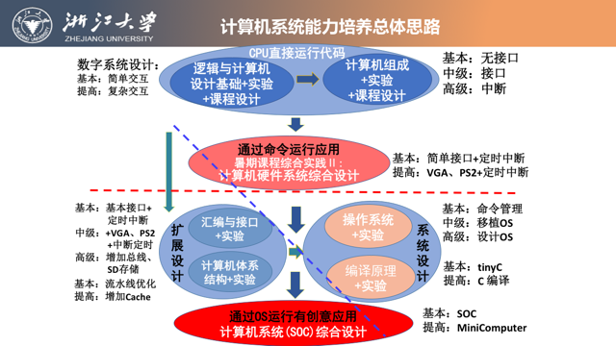

Slide 5
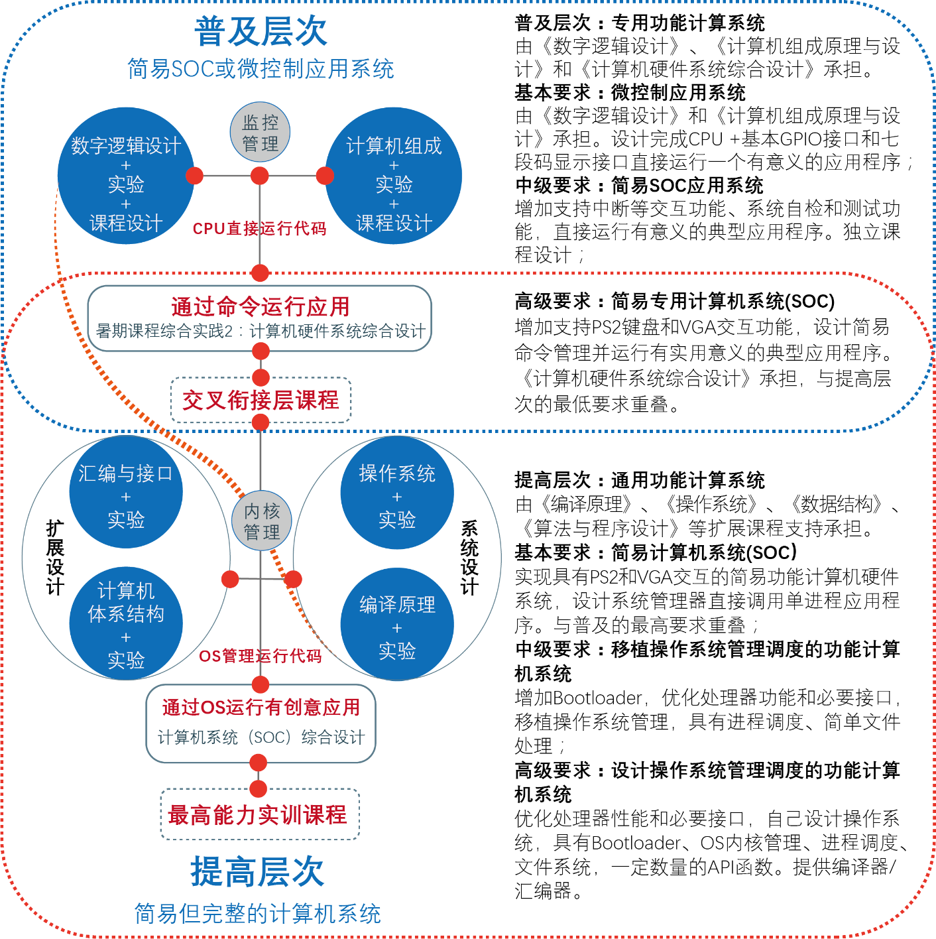
计算机系统能力培养总体思路

Slide 6





改革中的实验体系
自主研发统一的实验平台，建立实验成果库，构建系列化、递进式的实验体系
渐近的计算机硬件系统
Simple but Rich
CACHE
MMU
动态流水
ISA扩展
中断处理
数字逻辑→计算机组成(CPU) →体系结构(流水CPU) →简易计算机系统
高级数字系统设计→计算机接口 →SOC设计→计算机系统设计→多核系统设计
→嵌入式系统设计
操作系统 + 编译系统 + 应用软件

Slide 7
课程内容
教学内容 | 教学内容 | 备注
基础回顾 | ☆ 介绍计算机系统的基本设计思想、设计原理、设计技术。能够分析、设计计算机的相关功能部件及处理器 ☆ 现代计算机处理器中流水线技术、指令级并行性开发技术、多处理器计算机设计技术 | 约3次课
前沿研究 | ☆ 介绍当前计算机系统的前沿研究方向及研究内容 | 约3次课
业界分享 | ☆ 邀请业界的一线工程技术专家分享业界当前面临的技术挑战及解决方案 | 约3次课
学生汇报 | ☆ 各小组分享论文阅读成果 | 约6次课

Slide 8
课程内容
教学内容 | 备注
☆ 资源分解架构：将计算所需的资源分解到不同的机器上，再通过高性能网络进行连接，从而提高系统的可拓展性。 | 第5章
☆ 新型硬件卸载架构：利用新型高性能硬件，如GPU、FPGA等，提升系统性能和拓展性。 | 第6章
☆ 计算机体系架构前沿研究方向介绍：cache、分支预测、数据预取等 | 第7章

Slide 9
教材
英文（主要）：
《Computer Architecture--A Quantitative Approach》，6th，机械工业出版社原版影印，￥78。
中文（参考）：
《计算机体系结构－一种定量的方法》， 清华出版社，￥72

Slide 10
教材作者介绍
John L. Hennessy
Standford University校长、IEEE和ACM会员，美国国家工程研究院院士及美国科学艺术研究院院士，2001获Eckert-Mauchly奖（RISC），2001年Seymour Cray计算机工程奖得主，2000年获IEEE John von Neumann奖。
David A. Patterson
University of California, Berkeley教授，美国国家工程研究院院士， IEEE和ACM会员，获IEEE James H.Muligan教育奖章，1995获IEEE技术成就奖(RISC)，1999年IEEE Reynold Johnson信息存储奖，2000年获IEEE John von Neumann奖。

Slide 11
Eckert-Mauchly Award
2010 Bill Dally 2009 Joel Emer 2008 David Patterson 2007 Valero, Mateo 2006 Pomerene, James H 2005 Colwell, Robert P. 2004 Brooks, Frederick P. 2003 Fisher, Joseph A. (Josh) 2002 Rau, B. Ramakrishna (Bob) 2001 Hennessy, John 2000 Davidson, Edward 1999 Smith, James E. 1998 Watanabe, T. 1997 Tomasulo, Robert 1996 Patt, Yale 1995 Crawford, John | 1994 Thornton, James E. 1993 Kuck, David J 1992 Flynn, Michael J. 1991 Smith, Burton J. 1990 Batcher, Kenneth E. 1989 Cray, Seymour 1988 Siewiorek, Daniel P. 1987 Amdahl, Gene M. 1986 Cragon, Harvey G 1985 Cocke, John 1984 Dennis, Jack B. 1983 Kilburn, Tom 1982 Bell, C. Gordon 1981 Clark, Wesley A. 1980 Wilkes, Maurice V. 1979 Barton, Robert S.

Slide 12
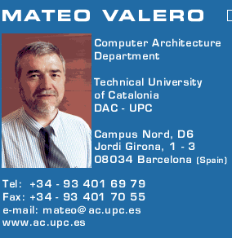
Big Men in Architecture(1)
2007Mateo Valero
http://personals.ac.upc.edu/mateo/
For important contributions to instruction level parallelism and superscalar processor design.

Slide 13
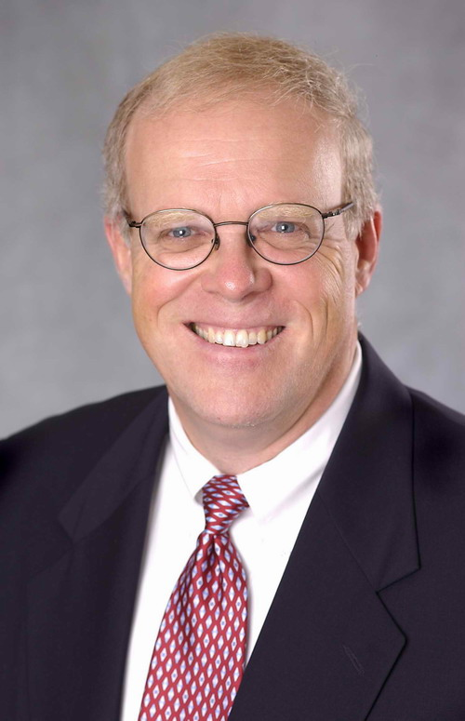
Big Men in Architecture(2)
2001 Hennessy, John
For being the founder and chief architect of the MIPS Computer Systems and contributing to the development of the landmark MIPS R2000 microprocessor.

Slide 14
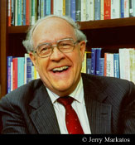
Big Men in Architecture(3)
2004 Eckert-Mauchly Award
"For the definition of computer architecture and contributions to the concept of computer families and to the principles of instruction set design; for seminal contributions in instruction sequencing, including interrupt systems and execute instructions; and for contributions to the IBM 360 instruction set architecture."
Frederick P. Brooks
http://www.cs.unc.edu/~brooks/
1999 ACM Turing Award
landmark contributions to computer architecture, operating systems, and software engineering."

Slide 15
Big Men in Architecture(4)
1997 Robert Tomasulo For the ingenious Tomasulo's algorithm, which enabled out-of-order execution processors to be implemented.
January 30 2008, Tomasulo spoke at the College of Engineering at the University of Michigan about his career and the history and development of out-of-order execution
http://inst-tech.engin.umich.edu/media/index.php?sk=tomasulo

Slide 16
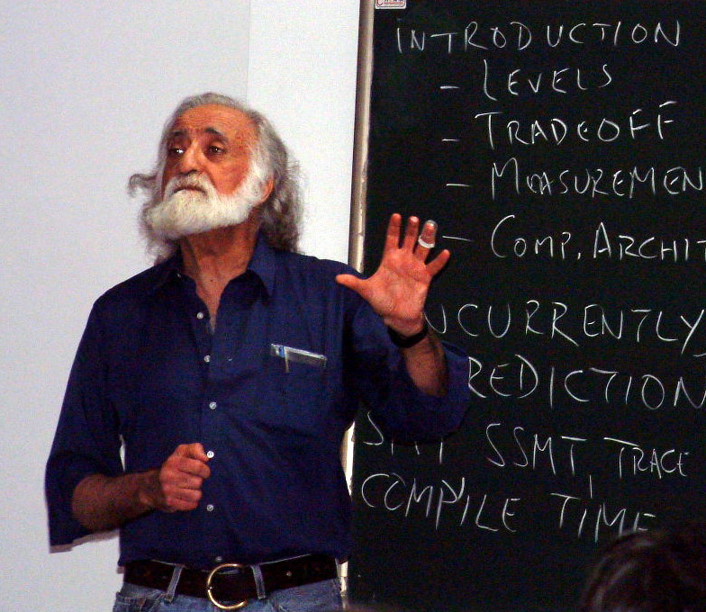
Big Men in Architecture(5)
1996 Yale Patt
For important contributions to instruction level parallelism and superscalar processor design.

Slide 17
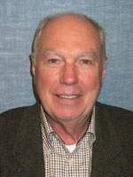
Big Men in Architecture(6)
1992 Michael J. Flynn
http://www.cpe.calpoly.edu/IAB/flynn.html
For his important and seminal contributions to processor organization and classification, computer arithmetic and performance evaluation.

Slide 18
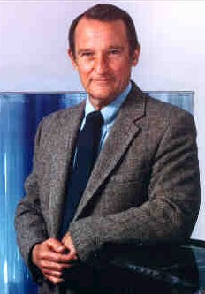
Big Men in Architecture(7)
1989 Cray, Seymour
For a career of achievements that have advanced supercomputing design.

Slide 19
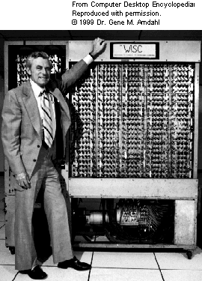
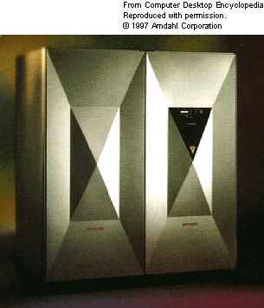
Big Men in Architecture(8)
1987 Amdahl, Gene M.
For outstanding innovations in computer architecture, including pipelining, instruction look-ahead, and cache memory.
In 1975, Dr. Amdahl stands beside the Wisconsin Integrally Synchronized Computer (WISC), which he designed in 1950. It was built in 1952. (Image courtesy of Dr. Gene M. Amdahl.)

Slide 20
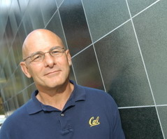
David A. Patterson （UC Berkeley）
He led the design and implementation of RISC I (the foundation of the SPARC architecture )
Leader of RAID
involved in the Network of Workstations (NOW) project
Research Accelerator for Multiple Processors (RAMP)

Slide 21
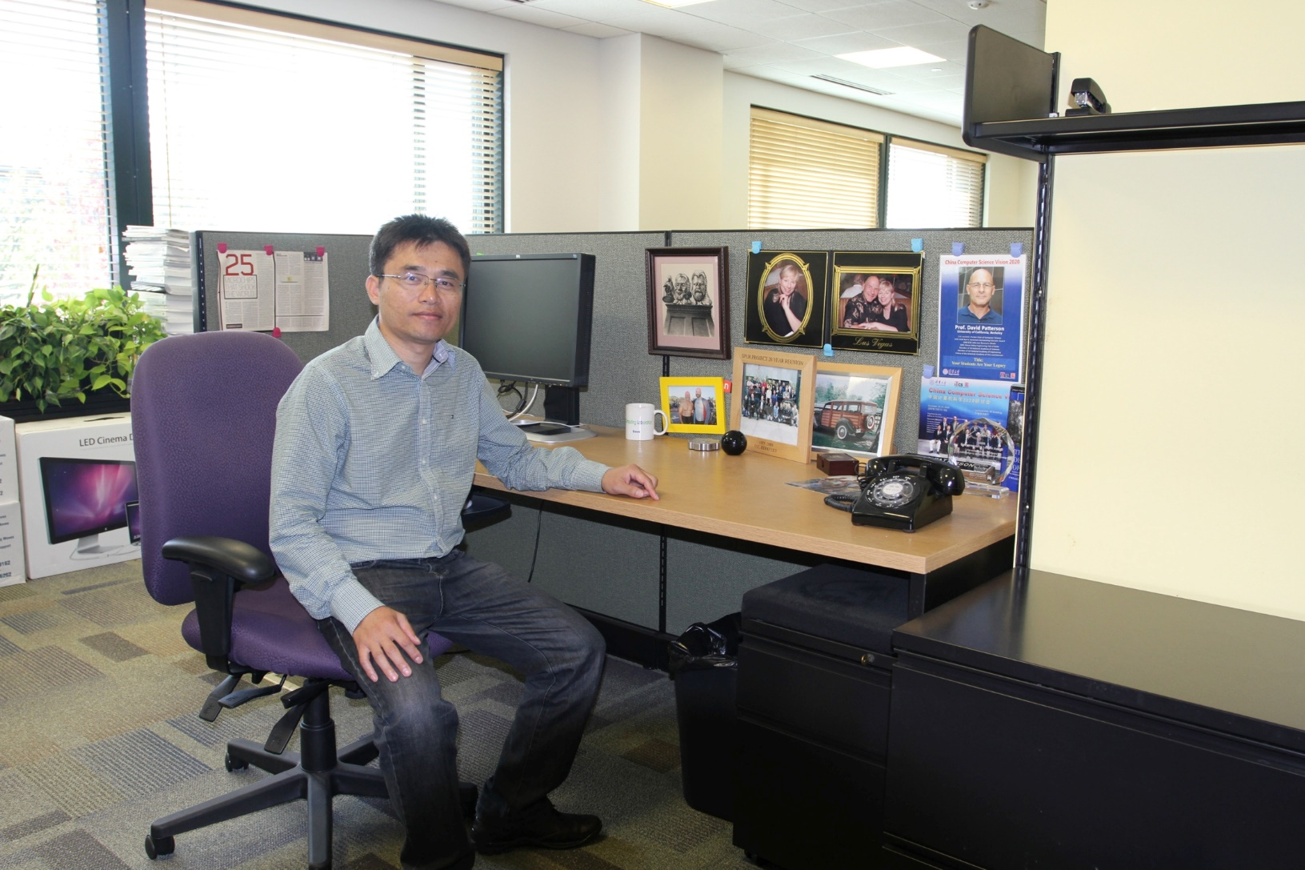

Slide 22
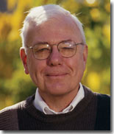
A. M. Turing Award-2009
Charles P Thacker
For the pioneering design and realization of the first modern personal computer -- the Alto at Xerox PARC -- and seminal inventions and contributions to local area networks (including the Ethernet), multiprocessor workstations, snooping cache coherence protocols, and tablet personal computers.

Slide 23
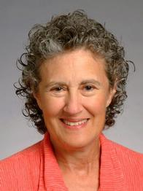
A. M. Turing Award-2008
Liskov, Barbara
For contributions to practical and theoretical foundations of programming language and system design, especially related to data abstraction, fault tolerance, and distributed computing.

Slide 24
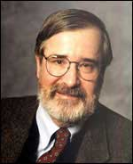
A. M. Turing Award-2007
Clarke, Edmund M
For his role in developing Model-Checking into a highly effective verification technology, widely adopted in the hardware and software industries.

Slide 25
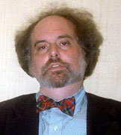
A. M. Turing Award-2007
Emerson, E Allen
For his role in developing Model-Checking into a highly effective verification technology, widely adopted in the hardware and software industries.

Slide 26

A. M. Turing Award-2007
Sifakis, Joseph
For his role in developing Model-Checking into a highly effective verification technology, widely adopted in the hardware and software industries.

Slide 27
Top conference in CA
ISCA: The International Symposium on Computer Architecture
MICRO: Intl Symp on Microarchitecture
ASPLOS: Architectural Support for Prog Lang and OS
HPCA: IEEE Symp on High-Perf Comp Architecture
OSDI: USENIX Symposium on Operating Systems Design and Implementation
SOSP: The ACM Symposium on Operating Systems Principles ……

Slide 28
Top10 HPC，2008
Rank | Site | Computer
1 | DOE/NNSA/LANL United States | Roadrunner - BladeCenter QS22/LS21 Cluster, PowerXCell 8i 3.2 Ghz / Opteron DC 1.8 GHz , Voltaire Infiniband IBM
2 | Oak Ridge National Laboratory United States | Jaguar - Cray XT5 QC 2.3 GHz Cray Inc.
3 | NASA/Ames Research Center/NAS United States | Pleiades - SGI Altix ICE 8200EX, Xeon QC 3.0/2.66 GHz SGI
4 | DOE/NNSA/LLNL United States | BlueGene/L - eServer Blue Gene Solution IBM
5 | Argonne National Laboratory United States | Blue Gene/P Solution IBM
6 | Texas Advanced Computing Center/Univ. of Texas United States | Ranger - SunBlade x6420, Opteron QC 2.3 Ghz, Infiniband Sun Microsystems
7 | NERSC/LBNL United States | Franklin - Cray XT4 QuadCore 2.3 GHz Cray Inc.
8 | Oak Ridge National Laboratory United States | Jaguar - Cray XT4 QuadCore 2.1 GHz Cray Inc.
9 | NNSA/Sandia National Laboratories United States | Red Storm - Sandia/ Cray Red Storm, XT3/4, 2.4/2.2 GHz dual/quad core Cray Inc.
10 | Shanghai Supercomputer Center China | Dawning 5000A - Dawning 5000A, QC Opteron 1.9 Ghz, Infiniband, Windows HPC 2008 Dawning

Slide 29
Fastest computer in China
2018
Tianhe-2A 61 petaflop/s
2008 ShuGuang5000A
180.6 TeraFlops
122.88TB RAM, 30720 computing Cell
2004 ShuGuang4000A
11 TeraFLOPS
rank 10 in top 500 in June, 2004
2003 ShenTeng6800
5.324 TeraFLOPS
2002 ShenTeng1800
2.04 TeraFLOPS
2000 YinHe IV
1024 CPU
1 TeraFLOPS

Slide 30
TOP 10, 11/2009
1 | Jaguar - Cray XT5-HE Opteron Six Core 2.6 GHz
2 | Roadrunner - BladeCenter QS22/LS21 Cluster, PowerXCell 8i 3.2 Ghz / Opteron DC 1.8 GHz, Voltaire Infiniband
3 | Kraken XT5 - Cray XT5-HE Opteron Six Core 2.6 GHz
4 | JUGENE - Blue Gene/P Solution
5 | Tianhe-1 - NUDT TH-1 Cluster, Xeon E5540/E5450, ATI Radeon HD 4870, Infiniband
6 | Pleiades - SGI Altix ICE 8200EX, Xeon QC 3.0 GHz/Nehalem EP 2.93 Ghz
7 | BlueGene/L - eServer Blue Gene Solution
8 | Blue Gene/P Solution
9 | Ranger - SunBlade x6420, Opteron QC 2.3 Ghz, Infiniband
10 | Red Sky - Sun Blade x6275, Xeon X55xx 2.93 Ghz, Infiniband

Slide 31
Top10 HPC，June, 2010
Rank | Site | Computer
1 | Oak Ridge National Laboratory United States | Jaguar - Cray XT5-HE Opteron Six Core 2.6 GHz Cray Inc.
2 | National Supercomputing Centre in Shenzhen (NSCS) China | Nebulae - Dawning TC3600 Blade, Intel X5650, NVidia Tesla C2050 GPU Dawning
3 | DOE/NNSA/LANL United States | Roadrunner - BladeCenter QS22/LS21 Cluster, PowerXCell 8i 3.2 Ghz / Opteron DC 1.8 GHz, Voltaire Infiniband IBM
4 | National Institute for Computational Sciences/University of Tennessee United States | Kraken XT5 - Cray XT5-HE Opteron Six Core 2.6 GHz Cray Inc.
5 | Forschungszentrum Juelich (FZJ) Germany | JUGENE - Blue Gene/P Solution IBM
6 | NASA/Ames Research Center/NAS United States | Pleiades - SGI Altix ICE 8200EX/8400EX, Xeon HT QC 3.0/Xeon Westmere 2.93 Ghz, Infiniband SGI
7 | National SuperComputer Center in Tianjin/NUDT China | Tianhe-1 - NUDT TH-1 Cluster, Xeon E5540/E5450, ATI Radeon HD 4870 2, Infiniband NUDT
8 | DOE/NNSA/LLNL United States | BlueGene/L - eServer Blue Gene Solution IBM
9 | Argonne National Laboratory United States | Intrepid - Blue Gene/P Solution IBM
10 | Sandia National Laboratories / National Renewable Energy Laboratory United States | Red Sky - Sun Blade x6275, Xeon X55xx 2.93 Ghz, Infiniband Sun Microsystems

Slide 32
TOP 10, 11/2010
1 | Tianhe-1A - NUDT TH MPP, X5670 2.93Ghz 6C, NVIDIA GPU, FT-1000 8C
2 | Jaguar - Cray XT5-HE Opteron 6-core 2.6 GHz
3 | Nebulae - Dawning TC3600 Blade, Intel X5650, NVidia Tesla C2050 GPU
4 | TSUBAME 2.0 - HP ProLiant SL390s G7 Xeon 6C X5670, Nvidia GPU, Linux/Windows
5 | Hopper - Cray XE6 12-core 2.1 GHz
6 | Tera-100 - Bull bullx super-node S6010/S6030
7 | Roadrunner - BladeCenter QS22/LS21 Cluster, PowerXCell 8i 3.2 Ghz / Opteron DC 1.8 GHz, Voltaire Infiniband
8 | Kraken XT5 - Cray XT5-HE Opteron 6-core 2.6 GHz
9 | JUGENE - Blue Gene/P Solution
10 | Cielo - Cray XE6 8-core 2.4 GHz

Slide 33
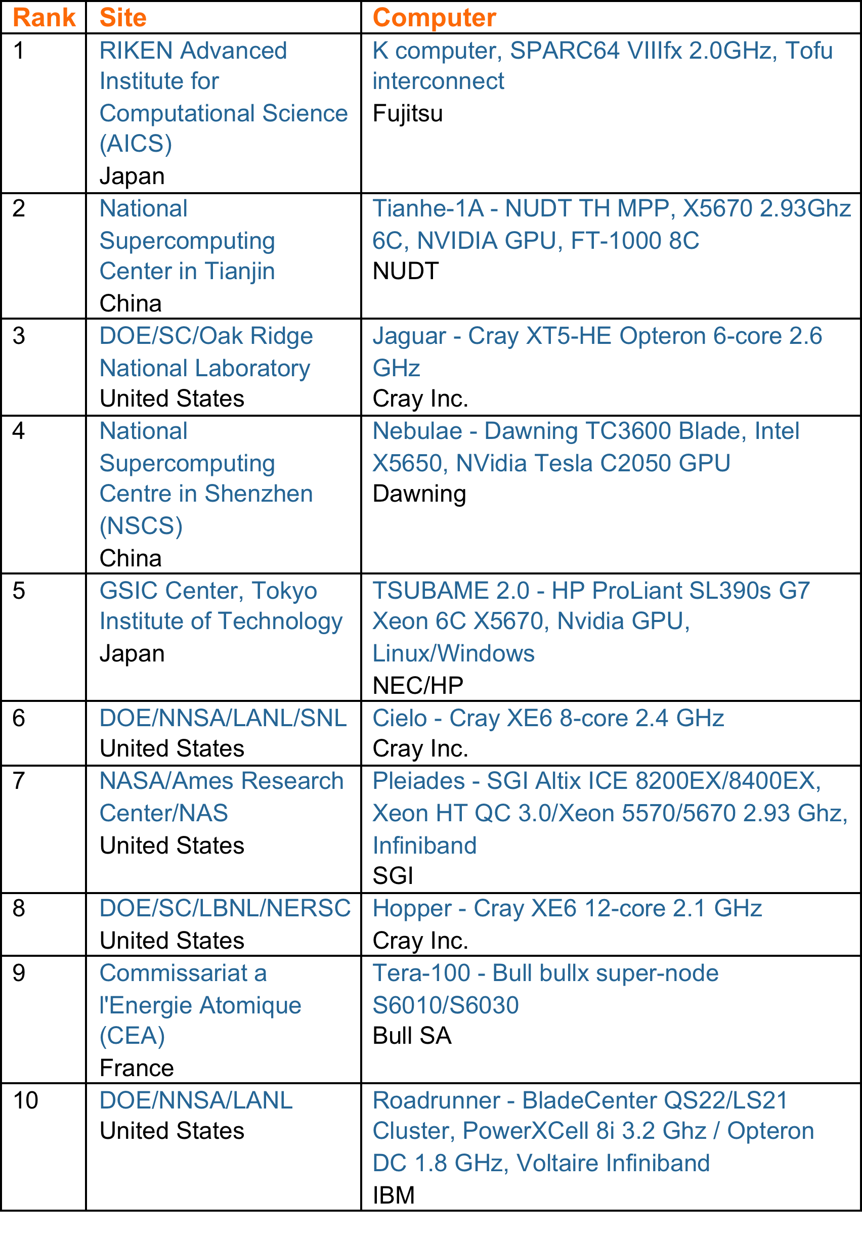
TOP 10 Sites for June 2011

Slide 34
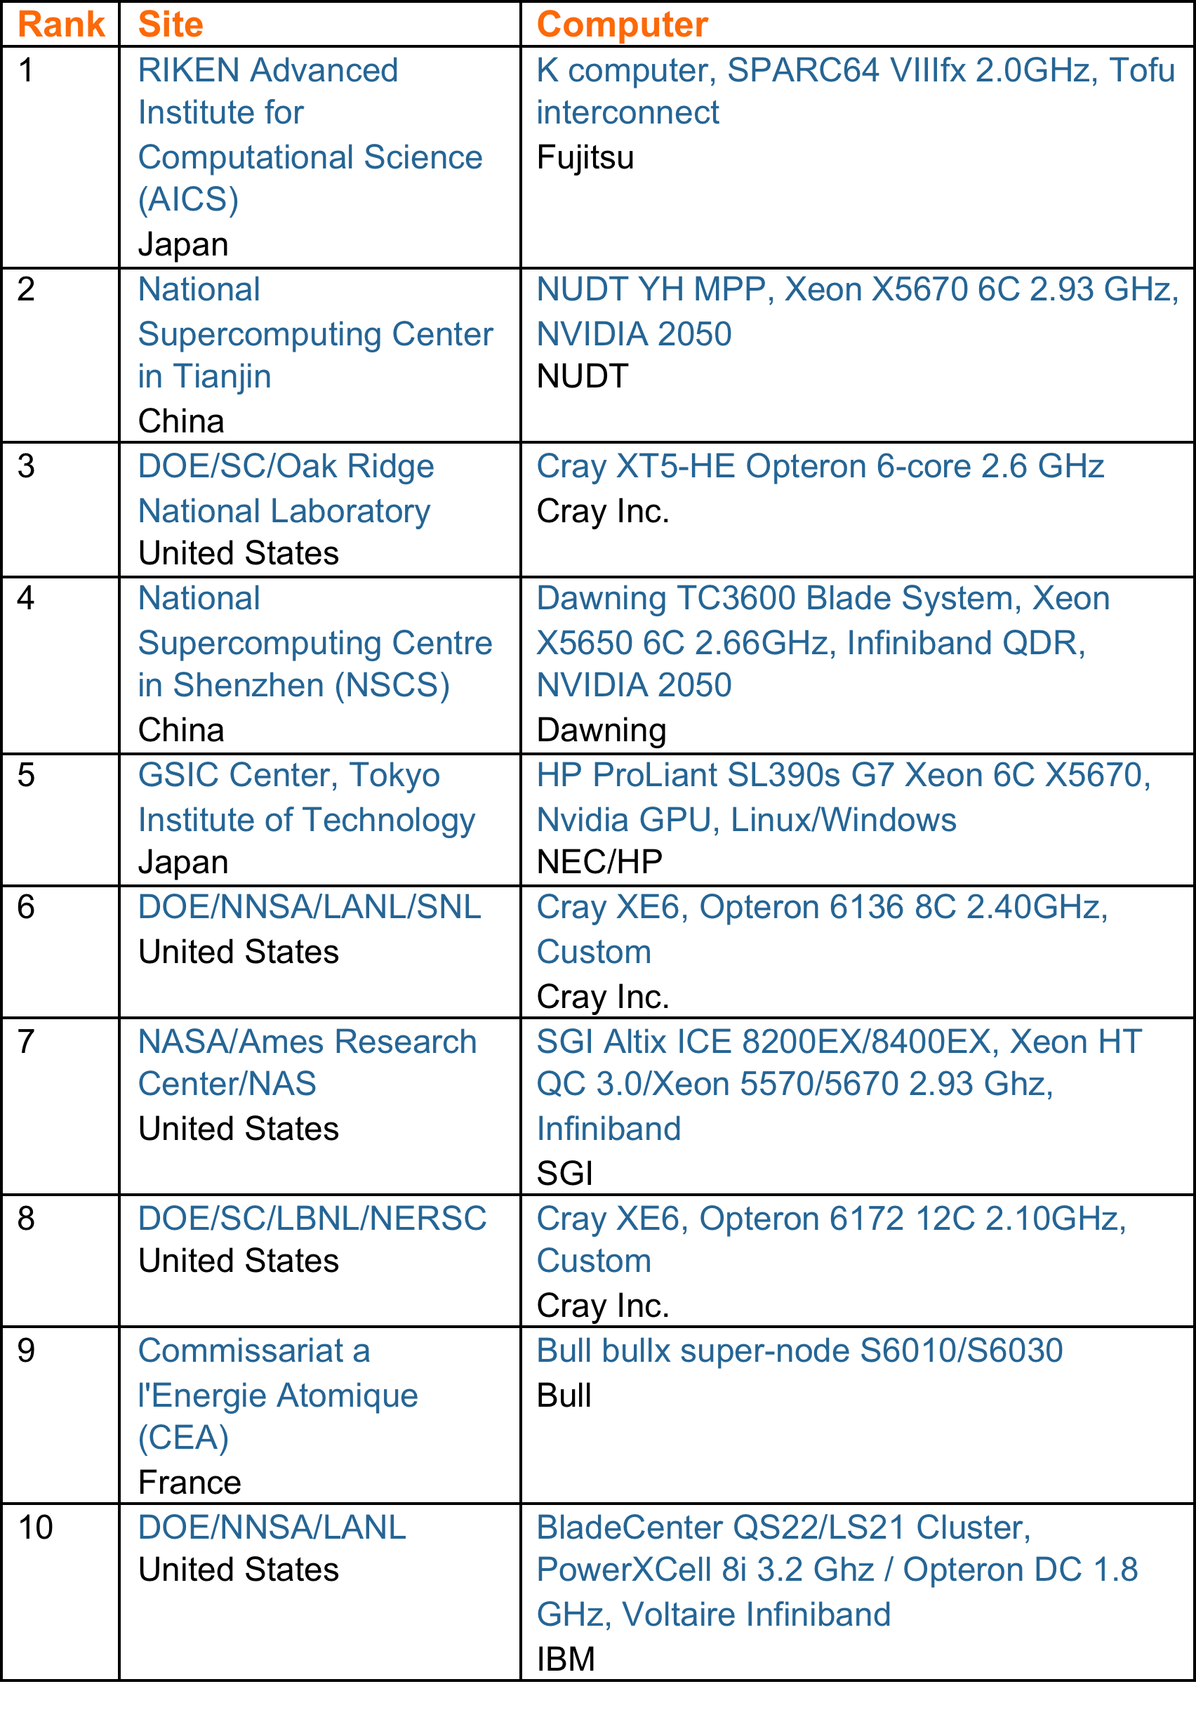
TOP 10 Sites for November 2011

Slide 35
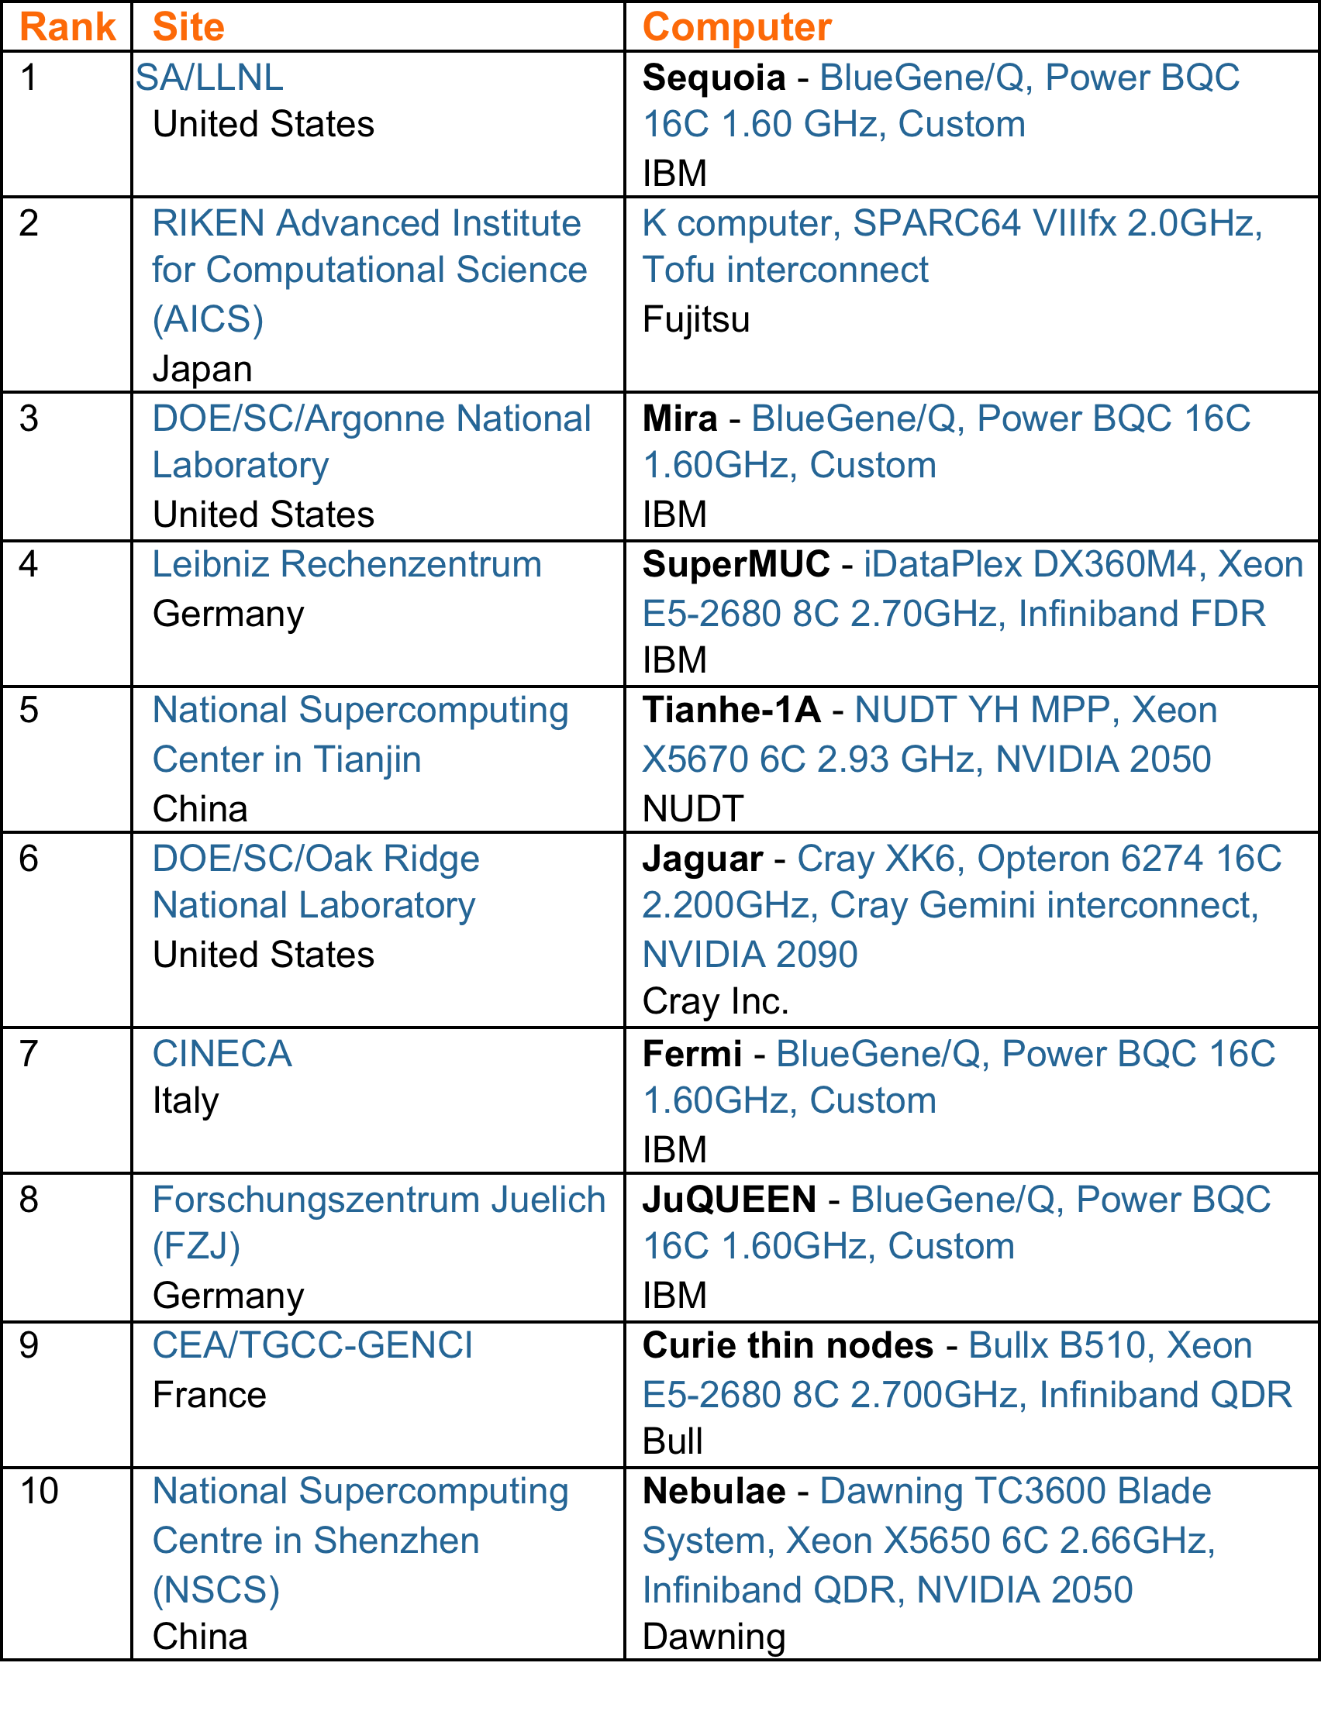
TOP 10 Sites for June 2012

Slide 36
TOP 10 Sites for November 2017
Rank | System | Cores | Rmax (TFlop/s) | Rpeak (TFlop/s) | Power (kW)
1 | Sunway TaihuLight - Sunway MPP, Sunway SW26010 260C 1.45GHz, Sunway , NRCPC | 10,649,600 | 93,014.6 | 125,435.9 | 15,371
2 | Tianhe-2A - TH-IVB-FEP Cluster, Intel Xeon E5-2692 12C 2.200GHz, TH Express-2, Intel Xeon Phi 31S1P , NUDT | 3,120,000 | 33,862.7 | 54,902.4 | 17,808
3 | Piz Daint - Cray XC50, Xeon E5-2690v3 12C 2.6GHz, Aries interconnect , NVIDIA Tesla P100 , Cray Inc. | 361,760 | 19,590.0 | 25,326.3 | 2,272
4 | Gyoukou - ZettaScaler-2.2 HPC system, Xeon D-1571 16C 1.3GHz, Infiniband EDR, PEZY-SC2 700Mhz , ExaScaler | 19,860,000 | 19,135.8 | 28,192.0 | 1,350
5 | Titan - Cray XK7, Opteron 6274 16C 2.200GHz, Cray Gemini interconnect, NVIDIA K20x , Cray Inc. | 560,640 | 17,590.0 | 27,112.5 | 8,209
6 | Sequoia - BlueGene/Q, Power BQC 16C 1.60 GHz, Custom , IBM | 1,572,864 | 17,173.2 | 20,132.7 | 7,890
7 | Trinity - Cray XC40, Intel Xeon Phi 7250 68C 1.4GHz, Aries interconnect , Cray Inc. | 979,968 | 14,137.3 | 43,902.6 | 3,844
8 | Cori - Cray XC40, Intel Xeon Phi 7250 68C 1.4GHz, Aries interconnect , Cray Inc. | 622,336 | 14,014.7 | 27,880.7 | 3,939
9 | Oakforest-PACS - PRIMERGY CX1640 M1, Intel Xeon Phi 7250 68C 1.4GHz, Intel Omni-Path , Fujitsu | 556,104 | 13,554.6 | 24,913.5 | 2,719
10 | K computer, SPARC64 VIIIfx 2.0GHz, Tofu interconnect , Fujitsu | 705,024 | 10,510.0 | 11,280.4 | 12,660

Slide 37
TOP 10, 06/2019
Rank | System | Cores | Rmax (TFlop/s) | Rpeak (TFlop/s) | Power (kW)
1 | Summit - IBM Power System AC922, IBM POWER9 22C 3.07GHz, NVIDIA Volta GV100, Dual-rail Mellanox EDR Infiniband , IBM | 2,414,592 | 148,600.00 | 200,794.90 | 10,096
2 | Sierra - IBM Power System S922LC, IBM POWER9 22C 3.1GHz, NVIDIA Volta GV100, Dual-rail Mellanox EDR Infiniband , IBM / NVIDIA / Mellanox | 1,572,480 | 94,640.00 | 125,712.00 | 7,438
3 | Sunway TaihuLight - Sunway MPP, Sunway SW26010 260C 1.45GHz, Sunway , NRCPC | 10,649,600 | 93,014.60 | 125,435.90 | 15,371
4 | Tianhe-2A - TH-IVB-FEP Cluster, Intel Xeon E5-2692v2 12C 2.2GHz, TH Express-2, Matrix-2000 , NUDT | 4,981,760 | 61,444.50 | 100,678.70 | 18,482
5 | Frontera - Dell C6420, Xeon Platinum 8280 28C 2.7GHz, Mellanox InfiniBand HDR , Dell EMC | 448,448 | 23,516.40 | 38,745.90
6 | Piz Daint - Cray XC50, Xeon E5-2690v3 12C 2.6GHz, Aries interconnect , NVIDIA Tesla P100 , Cray Inc. | 387,872 | 21,230.00 | 27,154.30 | 2,384
7 | Trinity - Cray XC40, Xeon E5-2698v3 16C 2.3GHz, Intel Xeon Phi 7250 68C 1.4GHz, Aries interconnect , Cray Inc. | 979,072 | 20,158.70 | 41,461.20 | 7,578
8 | AI Bridging Cloud Infrastructure (ABCI) - PRIMERGY CX2570 M4, Xeon Gold 6148 20C 2.4GHz, NVIDIA Tesla V100 SXM2, Infiniband EDR , Fujitsu | 391,680 | 19,880.00 | 32,576.60 | 1,649
9 | SuperMUC-NG - ThinkSystem SD650, Xeon Platinum 8174 24C 3.1GHz, Intel Omni-Path , Lenovo | 305,856 | 19,476.60 | 26,873.90
10 | Lassen - IBM Power System S922LC, IBM POWER9 22C 3.1GHz, Dual-rail Mellanox EDR Infiniband, NVIDIA Tesla V100 , IBM / NVIDIA / Mellanox | 288,288 | 18,200.00 | 23,047.20

Slide 38
TOP, 06/2021
Rank | System | Cores | Rmax (TFlop/s) | Rpeak (TFlop/s) | Power (kW)
1 | Supercomputer Fugaku - Supercomputer Fugaku, A64FX 48C 2.2GHz, Tofu interconnect D, Fujitsu | 7,630,848 | 442,010.0 | 537,212.0 | 29,899
2 | Summit - IBM Power System AC922, IBM POWER9 22C 3.07GHz, NVIDIA Volta GV100, Dual-rail Mellanox EDR Infiniband, IBM | 2,414,592 | 148,600.0 | 200,794.9 | 10,096
3 | Sierra - IBM Power System AC922, IBM POWER9 22C 3.1GHz, NVIDIA Volta GV100, Dual-rail Mellanox EDR Infiniband, IBM / NVIDIA / Mellanox | 1,572,480 | 94,640.0 | 125,712.0 | 7,438
4 | Sunway TaihuLight - Sunway MPP, Sunway SW26010 260C 1.45GHz, Sunway, NRCPC | 10,649,600 | 93,014.6 | 125,435.9 | 15,371
5 | Perlmutter - HPE Cray EX235n, AMD EPYC 7763 64C 2.45GHz, NVIDIA A100 SXM4 40 GB, Slingshot-10, HPE | 706,304 | 64,590.0 | 89,794.5 | 2,528
6 | Selene - NVIDIA DGX A100, AMD EPYC 7742 64C 2.25GHz, NVIDIA A100, Mellanox HDR Infiniband, Nvidia | 555,520 | 63,460.0 | 79,215.0 | 2,646
7 | Tianhe-2A - TH-IVB-FEP Cluster, Intel Xeon E5-2692v2 12C 2.2GHz, TH Express-2, Matrix-2000, NUDT | 4,981,760 | 61,444.5 | 100,678.7 | 18,482
8 | JUWELS Booster Module - Bull Sequana XH2000 , AMD EPYC 7402 24C 2.8GHz, NVIDIA A100, Mellanox HDR InfiniBand/ParTec ParaStation ClusterSuite, Atos | 449,280 | 44,120.0 | 70,980.0 | 1,764
9 | HPC5 - PowerEdge C4140, Xeon Gold 6252 24C 2.1GHz, NVIDIA Tesla V100, Mellanox HDR Infiniband, Dell EMC | 669,760 | 35,450.0 | 51,720.8 | 2,252
10 | Frontera - Dell C6420, Xeon Platinum 8280 28C 2.7GHz, Mellanox InfiniBand HDR, Dell EMC | 448,448 | 23,516.4 | 38,745.9 | NA

Slide 39
Outlook
Open-source Architecture
RISC-V
Security Risks
Spectre and Meltdown
Intel ME
Security Improvements
Domain Specific Architectures
Hardware Accelerating
Processing near/in Memory

Slide 40

Open Source Architecture
RISC-V
A completely open ISA based on RISC principles
Freely available to academia and industry
Simple and extendable modular design
A small base integer ISA (RV32I, etc.)
Optional standard extensions
Free implementations & commercial implementations
Free: Rocket, PULPino, Hummingbird…
Commercial: SiFive
Notes:
https://riscv.org/risc-v-cores/

Slide 41
Security Risks
Spectre & Meltdown
Complicated techniques are widely used on modern processors to improve performance
However, these widely-used techniques may cause security risks
Out-of-order execution
Meltdown
Branch predication & speculative execution
Spectre
Intel Management Engine
Notes:
https://meltdownattack.com/
https://en.wikipedia.org/wiki/Intel_Management_Engine
Intel Management Engine
A ”secret” microprocessor built in all Intel processors since 2008
Runs proprietary firmware while computer is running, asleep or even turned off

Slide 42
Security Improvements
Pointer Authentication
The actual address space of a 64-bit architecture is less than 64-bits.
We can place a “signature” of pointer in unused bits, to prove it comes from a valid operation, rather than a software flaw.
New instructions to sign/authenticate pointers.
Enclave (Intel SGX)
Keeping trusted environment on a untrusted platform is challenging.
Untrusted OS/Malware/Cloud
Root of trust on the CPU
If you trust CPU’s vendor, you can probably trust its enclave

Slide 43
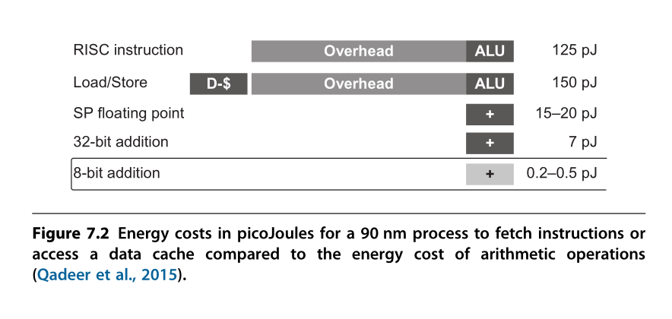
Domain Specific Architectures
General processors are not efficient when solving specific problems
Performance & Energy
To achieve a higher level of efficiency, we need a drastic change in computer architecture from general-purpose cores to domain-specific architectures (DSAs).

Slide 44
Domain Specific Architectures
Google TPU
Data center ASIC
Google Pixel vCore
Mobile device ASIC
寒武纪 NPU
Mobile/Data center IP

Slide 45
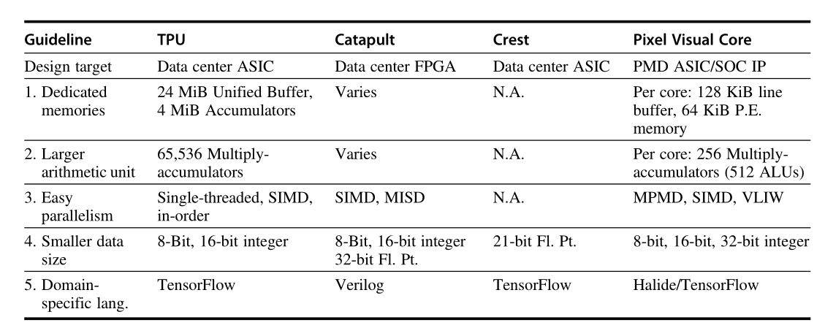

Slide 46

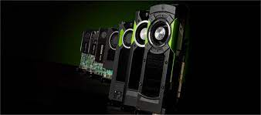
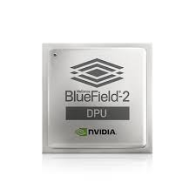
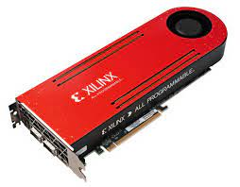

Hardware Accelerating
Background
Moore's law fails on the CPU
Dedicated hardware can get a greater improvement than CPU in certain scenarios
Notes:
如果数据发生了cache miss，那么就要到DRAM去找，这个过程非常消耗时间，大约100ns。数据预取就是在load指令执行之前，提前把数据取到cache中，降低load-to-use的延迟

Slide 47
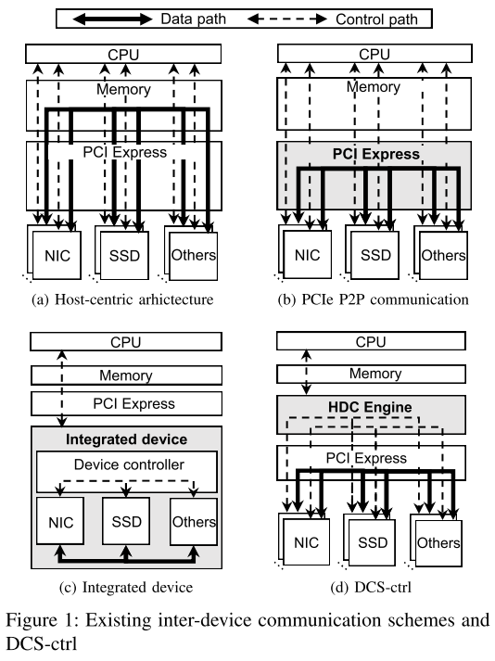
Hardware Accelerating
The development trend of computer architecture
From Host-centric (CPU Centric) to device-centric.
Making full use of the powerful computing power of new hardware.

Slide 48








Data Prefetching
L1 L2
DRAM
Without prefetching:
With prefetching:
Load
Data
Total Load-to-Use Latency
time
Prefetch
Load Data
Much improved Load-to-Use Latency
Prefetch
Load Data
Somewhat improved Latency
Notes:
如果数据发生了cache miss，那么就要到DRAM去找，这个过程非常消耗时间，大约100ns。数据预取就是在load指令执行之前，提前把数据取到cache中，降低load-to-use的延迟

Slide 49
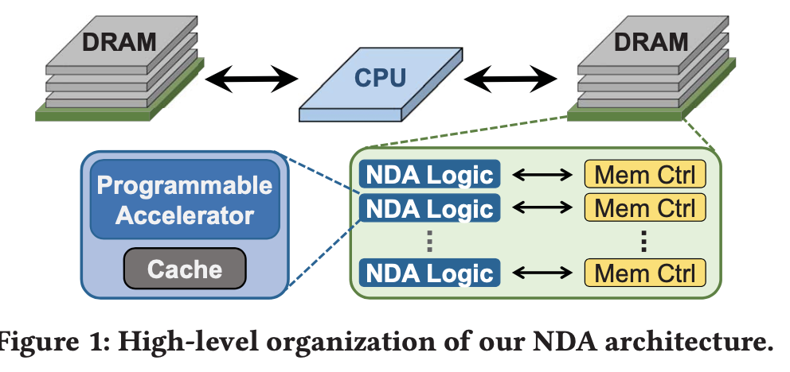
Processing near/in Memory
Offload computing into DRAM

Slide 50
课程考核
方式：
课堂汇报
论文综述

Slide 51
课程要求
1、全班同学自由分组，每组3~4人；
在第二次课上课前分组完成
分组完成后，通过钉钉课程群告知助教
2、每组同学从给定的论文列表中选择某一方向的数篇论文进行阅读，之后在课堂上进行15分钟左右的汇报；
汇报时需要说明成员工作量，作为评分依据；
汇报顺序按照登记顺序倒序；

Slide 52
课程要求
3、最后一次课结束后一周内，每位同学需要提交一篇论文综述；
不少于5000字；
不少于10篇参考文献；
4、总成绩=小组汇报成绩50%+论文综述成绩50%

Slide 53
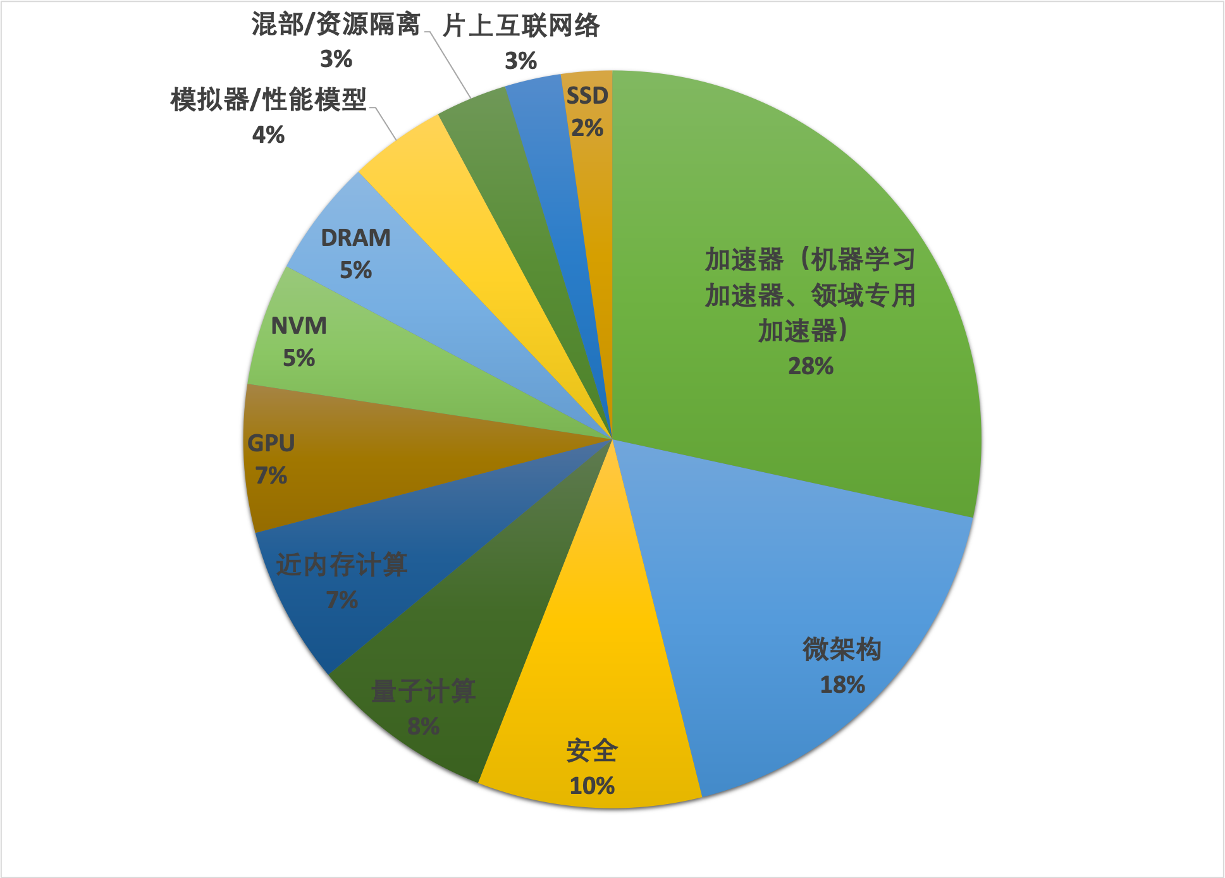
近3年HPCA, ISCA, MICRO论文分布

Slide 54
参考论文
Cache替换策略
分支预测
数据预取
投机执行攻击
近内存计算
领域特定架构（DSA）
稀疏矩阵乘法加速
深度神经网络加速
硬件加速
详细列表已上传至学在浙大平台

Slide 55

学在浙大
https://courses.zju.edu.cn

Slide 56
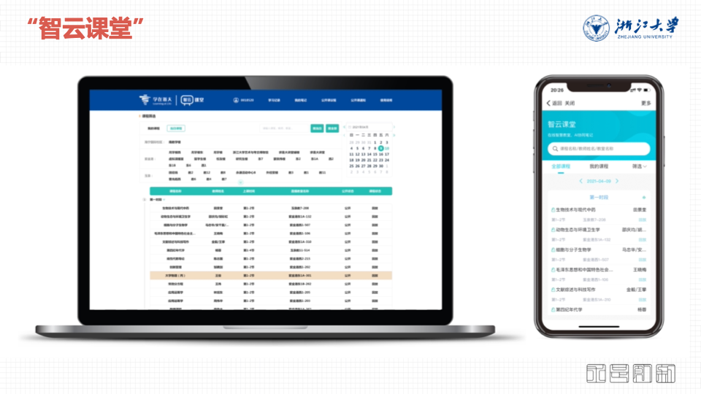
智云课堂
https://classroom.zju.edu.cn

Slide 57

THANK YOU
THANK YOU

